Slide 1
Serverprogrammering
Gruppprojekt – grupp 1

Slide 2

Vad har vi gjort?
Profile
Forum
Social media
Spel
etc...

Slide 3
Arbetsgången
Hur har vi lagt upp arbetet?
Mycket parprogrammering av kärnkoden
Individuellt städat och fixat mindre detaljer
Hur har vi kommunicerat?
Några få gånger på plats
Mestadels distans
Discord
Code With Me (IntelliJ)

Slide 4
Arbetsgången
Hur har vi delat upp arbetet? Vem har gjort vad?
Planerade att dela upp projektet i delar mellan oss
Blev att vi gjorde det tillsammans

Slide 5


Komponenterna
Backend
Server: WildFly
Databas: MySQL
Docker-Compose
Droplet på DigitalOcean.com
Frontend/Klient
RESTeasy
Verktyg
IntelliJ
Postman

Slide 6
Docker-Compose
version: '3.3'
services:
backend:
container_name: "backend"
build: ./backend
environment:
- WILDFLY_USER=admin
- WILDFLY_PASS=adminPassword
depends_on:
- database
ports:
- "8080:8080" # application
- "9990:9990" # admin console
links:
- database
database:
container_name: "db"
image: "mysql:latest"
environment:
- MYSQL_DATABASE=sample
- MYSQL_USER=mysql
- MYSQL_PASSWORD=mysql
- MYSQL_ROOT_PASSWORD=supersecret
cap_add:
- SYS_NICE
volumes:
- ./workdir/db/init/:/docker-entrypoint-initdb.d/
- ./workdir/db/data/:/var/lib/mysql/
ports:
- "3306:3306"
WildFly
MySQL

Slide 7
./backend/Dockerfile (WildFly)
FROM quay.io/wildfly/wildfly
RUN /opt/jboss/wildfly/bin/add-user.sh admin Admin#70365 –silent
RUN curl https://repo1.maven.org/maven2/mysql/mysql-connector-java/8.0.28/mysql-connector-java-8.0.28.jar -O
RUN mkdir -p wildfly/modules/system/layers/base/com/mysql/main
RUN mv mysql-connector-java-8.0.28.jar wildfly/modules/system/layers/base/com/mysql/main
CMD ["/opt/jboss/wildfly/bin/standalone.sh", "-b", "0.0.0.0", "-bmanagement", "0.0.0.0"]
$ docker-compose up

Slide 8
Backend i docker på DigitalOcean Droplet
*** System restart required ***
Last login: Mon Mar 28 10:41:47 2022 from 62.88.128.136
root@ubuntu-VT2022-mpl:~# docker ps
CONTAINER ID IMAGE COMMAND CREATED STATUS PORTS NAMES
87821e774ad5
wildfly-mysql-dockercompose-main_backend
"/opt/jboss/wildfly/…"
8 days ago Up 8 days
0.0.0.0:8080->8080/tcp, :::8080->8080/tcp,
0.0.0.0:9990->9990/tcp, :::9990->9990/tcp backend
7146be71550b
mysql:latest
"docker-entrypoint.s…"
8 days ago Up 8 days
0.0.0.0:3306->3306/tcp, :::3306->3306/tcp,
33060/tcp db
root@ubuntu-VT2022-mpl:~#

Slide 9
Konfigurera WildFly
$ docker exec -it <Wildfly container id> bash
[jboss@87821e774ad5 ~]$ /opt/jboss/wildfly/bin/jboss-cli.sh –c
[standalone@localhost:9990 /]
module add
--name=com.mysql
--resources=/opt/jboss/wildfly/modules/system/layers/base
/com/mysql/main/mysql-connector-java-8.0.28.jar
--dependencies=javax.api,javax.transaction.api
[standalone@localhost:9990 /]
/subsystem=datasources/jdbc-driver=mysql:add(driver-name=mysql,
driver-module-name=com.mysql)
[standalone@localhost:9990 /]
data-source add
--jndi-name=java:/MySqlDS
--name=MySQLPool --connection-url=jdbc:mysql://172.20.0.2:3306/sample
--driver-name=mysql --user-name=mysql --password=mysql
Command Line Interface
Lägga till modul
Lägga till MySQL JDBC driver
Lägga till vår datasource/databas

Slide 10
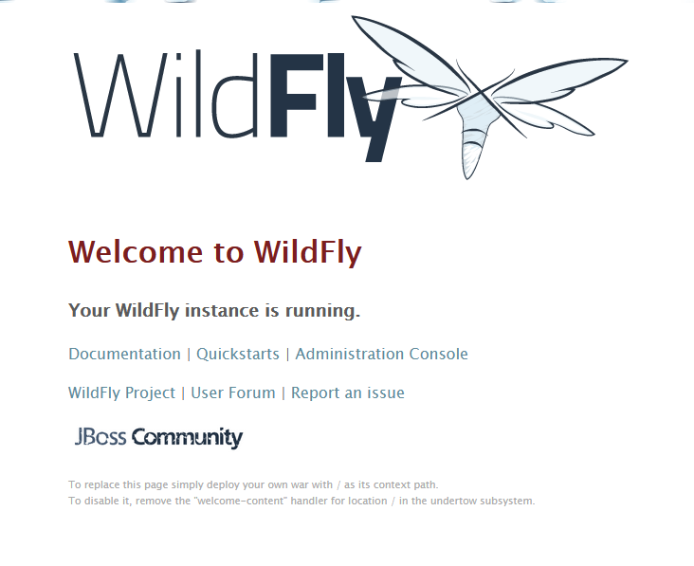
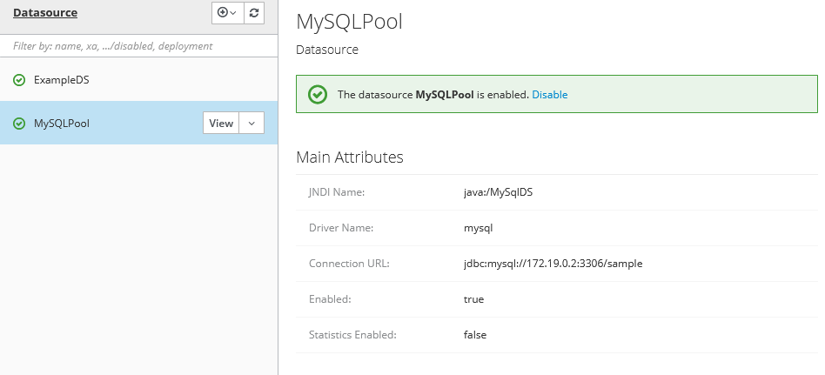
Konfigurera WildFly

Slide 11
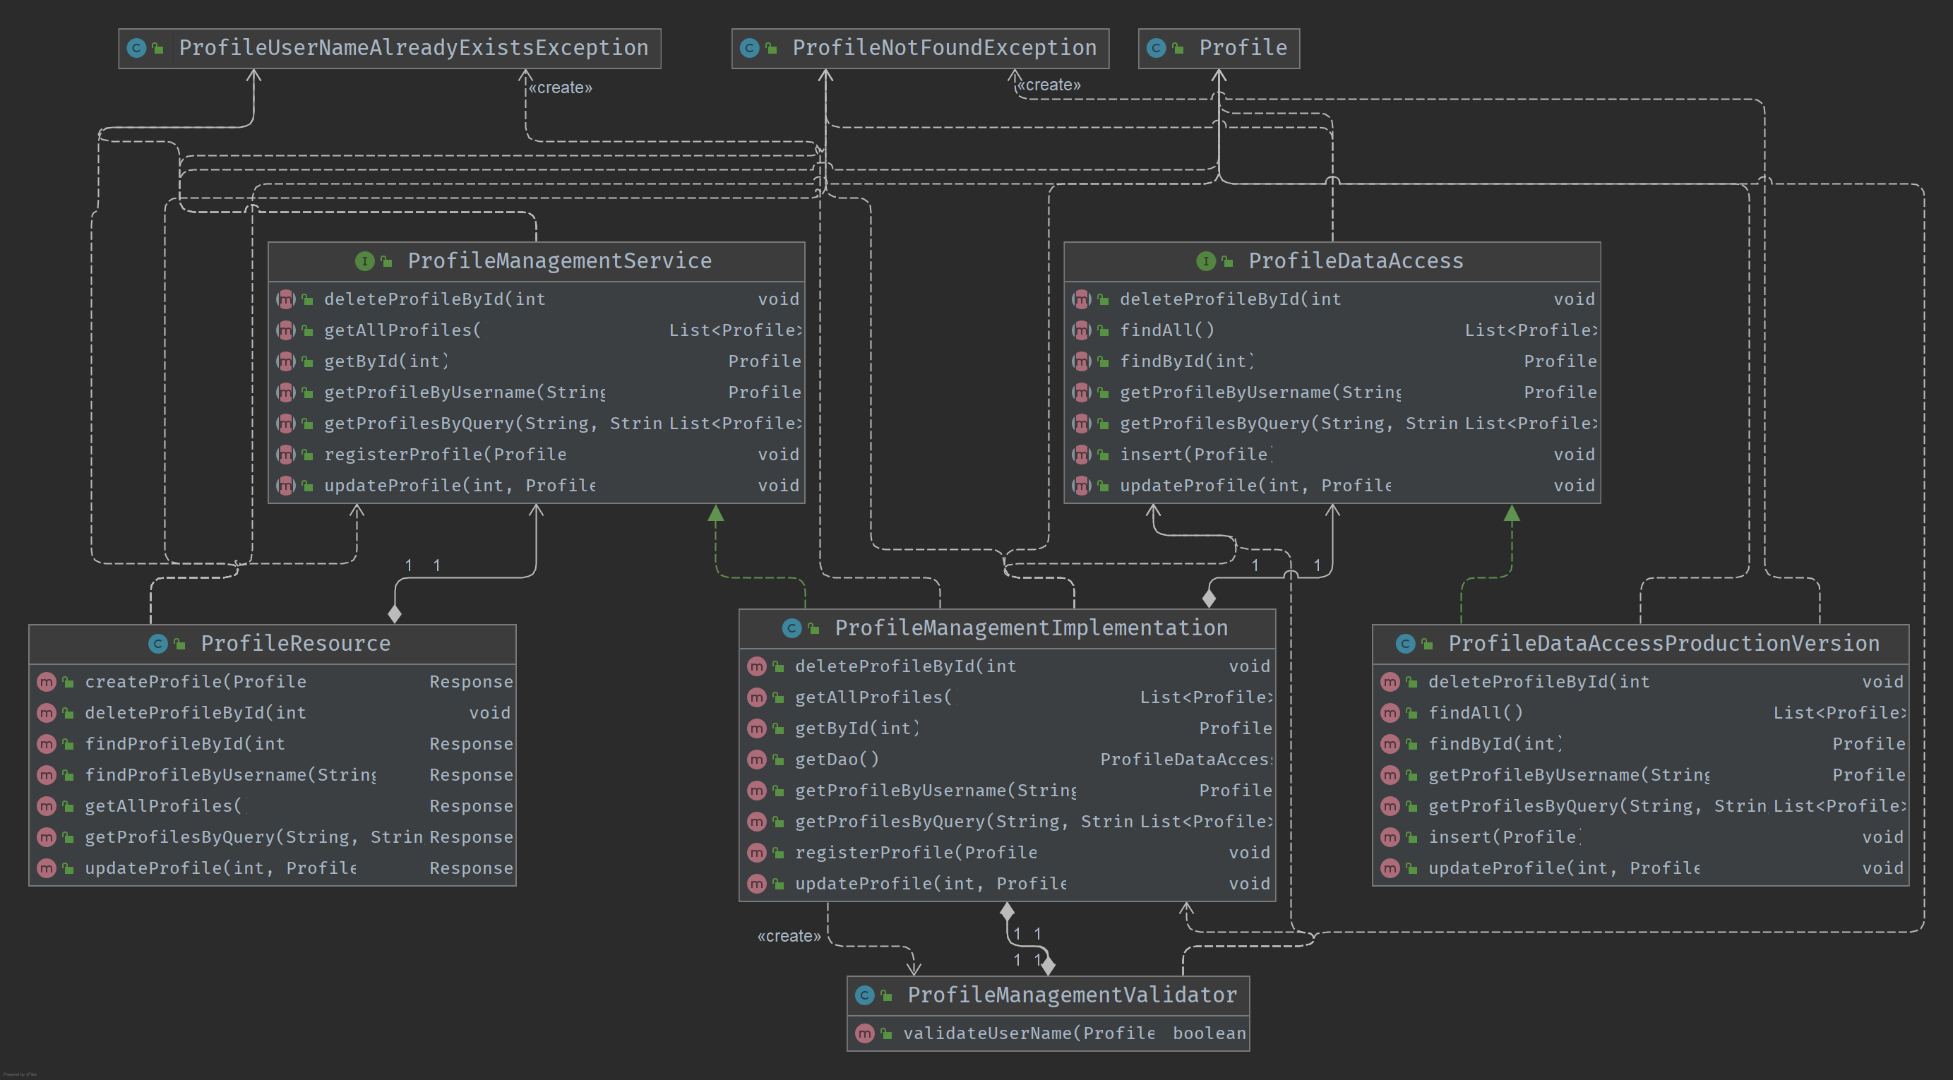
Serverkod
Domän
JPA
Interface
Interface
Databas
REST
”Affärslogik”
JAX-RS
JPA

Slide 12
Maven Server
POM.xml
Wildfly plugin
<packaging>war</packaging> <finalName>Grupp1ServerApplication</finalName>
<plugins> <plugin> <artifactId>maven-war-plugin</artifactId> <version>3.3.1</version>
<configuration> <webResources> <resource> <directory>${project.basedir}</directory> <targetPath>WEB-INF/</targetPath> <filtering>false</filtering> <includes> <include>web.xml</include> </includes> </resource> <resource> <directory>${project.basedir}</directory> <targetPath>META-INF/</targetPath> <filtering>false</filtering> <includes> <include>persistence.xml</include> </includes> </resource> </webResources> </configuration>
</plugin>
<plugin> <groupId>org.wildfly.plugins</groupId> <artifactId>wildfly-maven-plugin</artifactId> <version>2.1.0.Final</version> <configuration> <hostname>XXXX.XX.XX.XXXX</hostname> <port>9990</port> <username>XXX</username> <password>XXX</password> </configuration> </plugin> </plugins> </build> <dependencies>
<dependency> <groupId>org.jboss.spec</groupId> <artifactId>jboss-javaee-all-7.0</artifactId> <version>1.1.1.Final</version> <scope>compile</scope> </dependency>
</dependencies> </project>
Maven war plugin
web.xml
Java EE 7 dependency
persistence.xml
mvn wildfly:deploy

Slide 13
Demonstration av klientapplikationen!

Slide 14
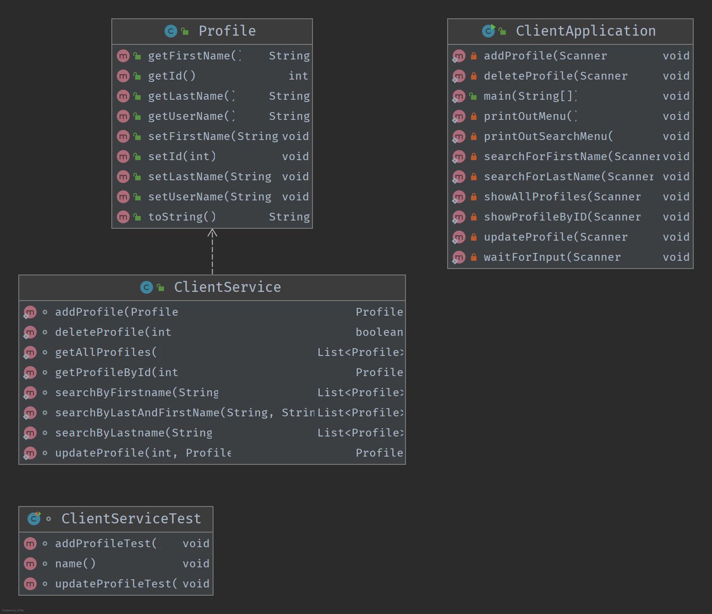
Klientkod
Model
Main
RESTeasy Client
Test

Slide 15
Maven Klient
POM.xml
<dependency> <groupId>org.jboss.resteasy</groupId> <artifactId>resteasy-client</artifactId> <version>6.0.0.Final</version> </dependency> <dependency> <groupId>org.jboss.resteasy</groupId> <artifactId>resteasy-jackson2-provider</artifactId> <version>6.0.0.Final</version> </dependency>
<dependency> <groupId>org.junit.jupiter</groupId> <artifactId>junit-jupiter</artifactId> <version>5.8.2</version> <scope>test</scope> </dependency>
<build> <plugins> <plugin> <groupId>org.apache.maven.plugins</groupId> <artifactId>maven-surefire-plugin</artifactId> <version>2.22.2</version> </plugin> </plugins> </build>
Surefire plugin
RESTeasy Client
Jackson2
JUnit

Slide 16
Utmaningar och svårigheter
Få ihop WildFly och Databasen i docker
Konfigurera WildFly på servern
Använda maven

Slide 17
Tack tack

